Slide 1

STRUCTURED QUERY LANGUAGE

Slide 2
PART 1
INSTALLATION OF MYSQL WORKBENCH

Slide 3
INTRO
The MySQL software delivers a very fast, multithreaded, multi-user, and robust SQL (Structured Query Language) database server.
MySQL, the most popular Open-Source SQL database management system, is developed, distributed, and supported by Oracle Corporation.
The official way to pronounce “MySQL” is “My Ess Que Ell” (not “my sequel”), but we do not mind if you pronounce it as “my sequel” or in some other localized way.
MySQL is a database management system.-- A database is a structured collection of data.
MySQL databases are relational. --A relational database stores data in separate tables rather than putting all the data in one big storeroom.
MySQL software is Open Source. --Open-Source means that it is possible for anyone to use and modify the software. Anybody can download the MySQL software from the Internet and use it without paying anything.
The MySQL Database Server is very fast, reliable, scalable, and easy to use.
MySQL Server can run comfortably on a desktop or laptop, alongside your other applications, web servers, and so on, requiring little or no attention

Slide 4
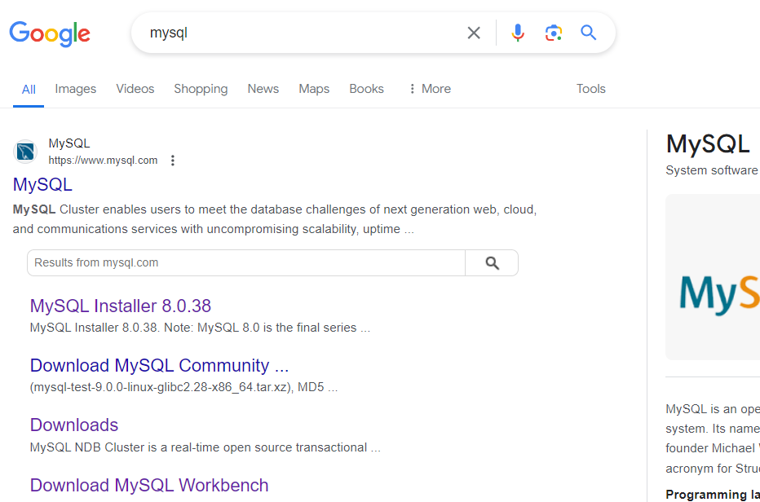
INSTALLATION OF MYSQL
In browser search MYSQL. Open the official site of MySQL

Slide 5
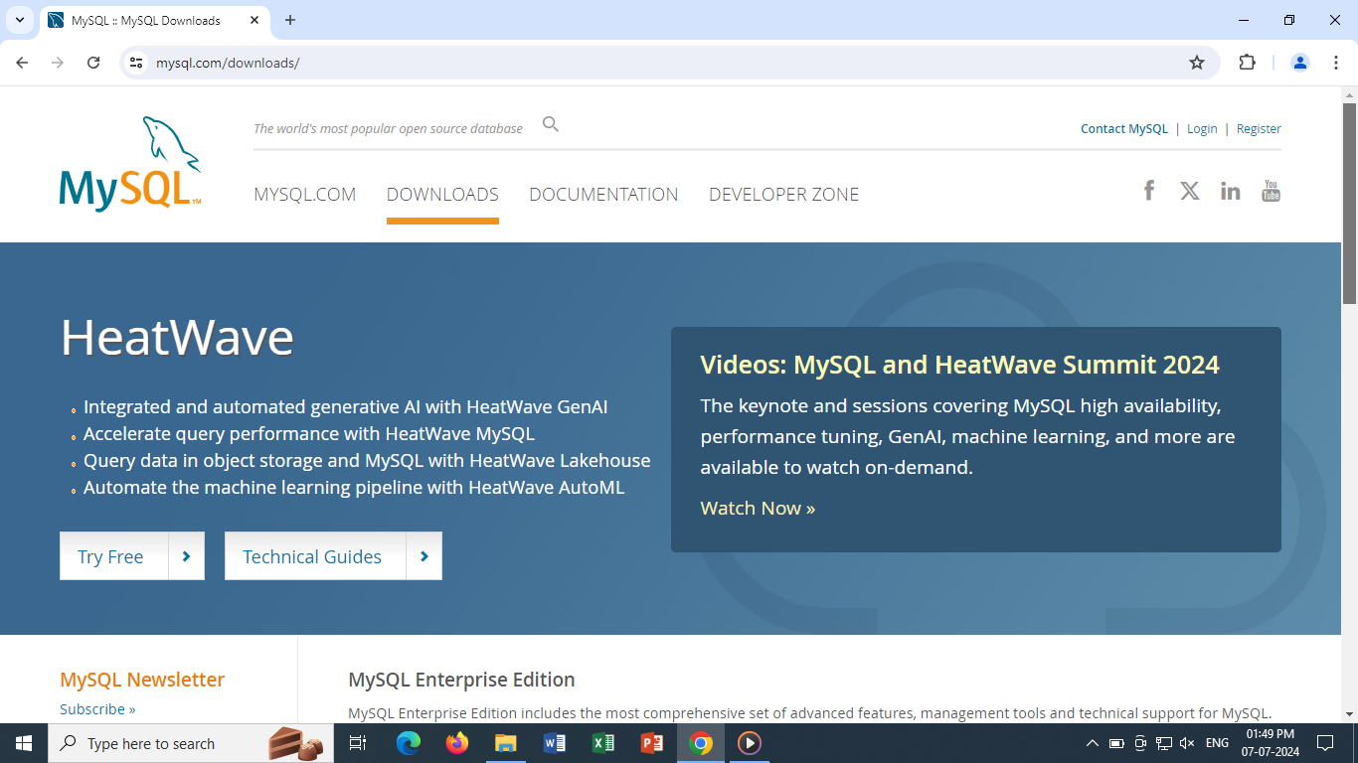
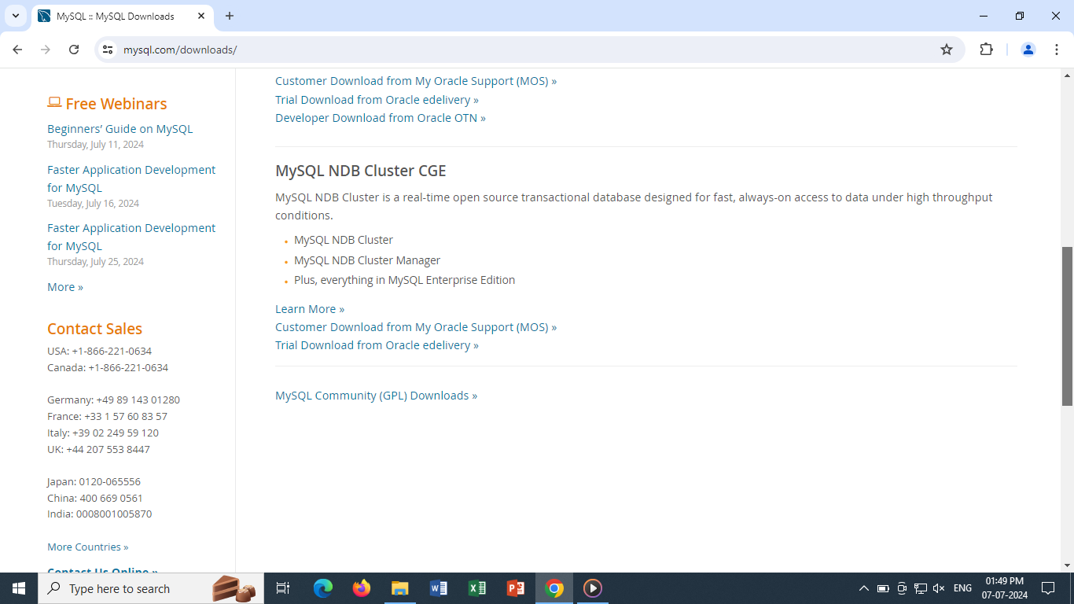
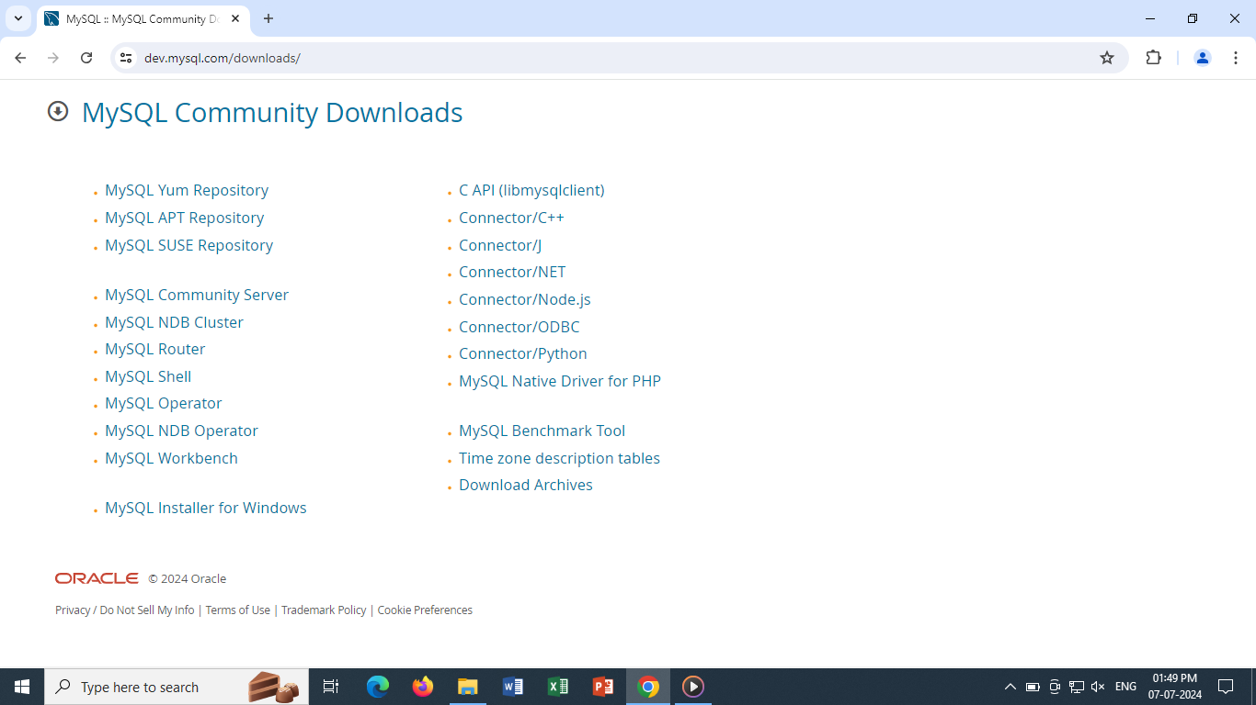
On website select “DOWNLOADS” tab, scroll to the bottom of page and select “MYSQL Community Downloads”. From the given list select “MySQL Installer for Windows”

Slide 6
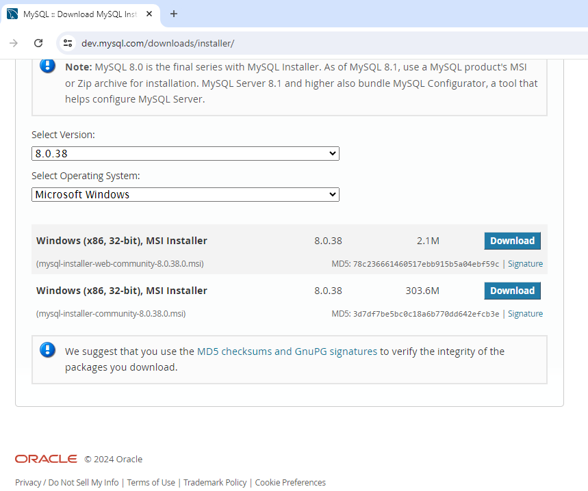
Here you reach to installer page.
You can see which version will be downloaded, some information about MySQL like it is offered by Oracle.
Select installer community to download .exe on your desktop.
First, web-community installer is online where you need network connectivity while working on workbench
Whereas second installer- is offline.
Here offline installer is being downloaded

Slide 7
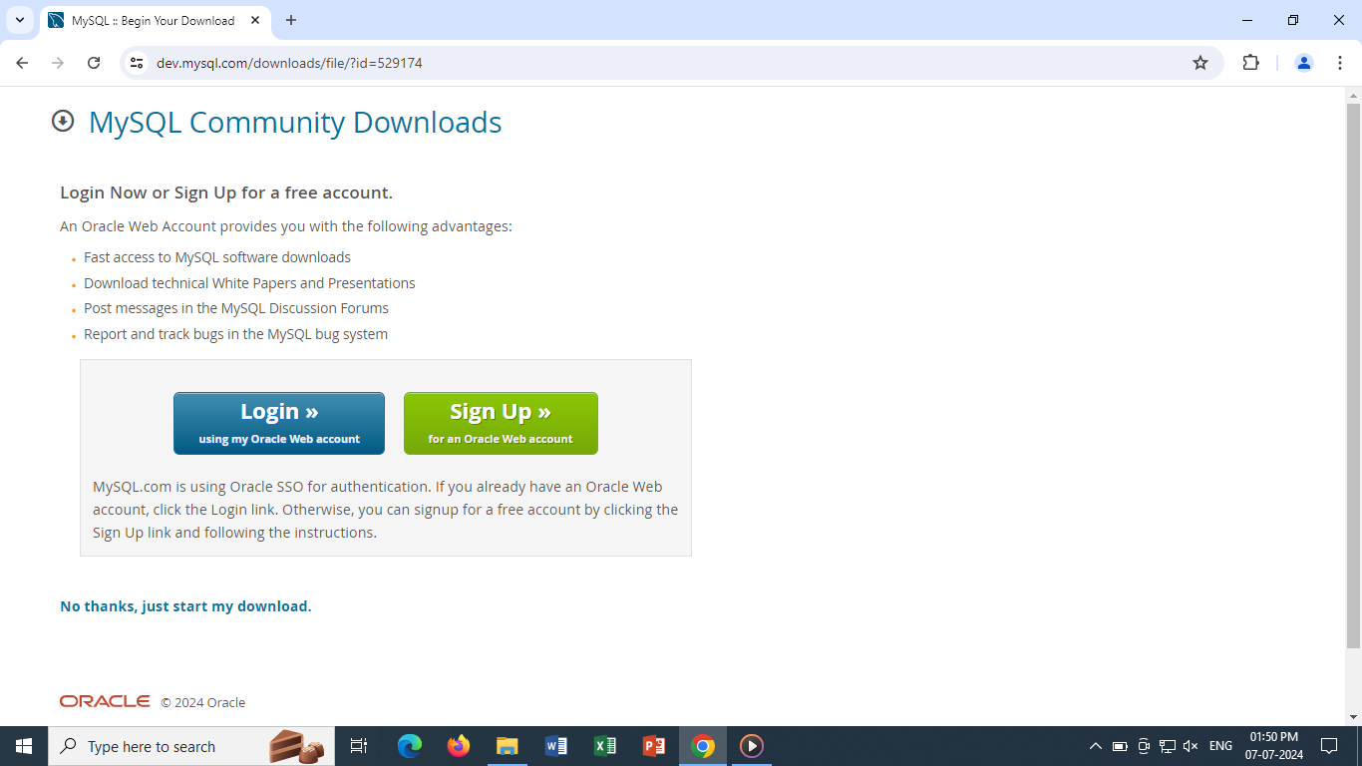
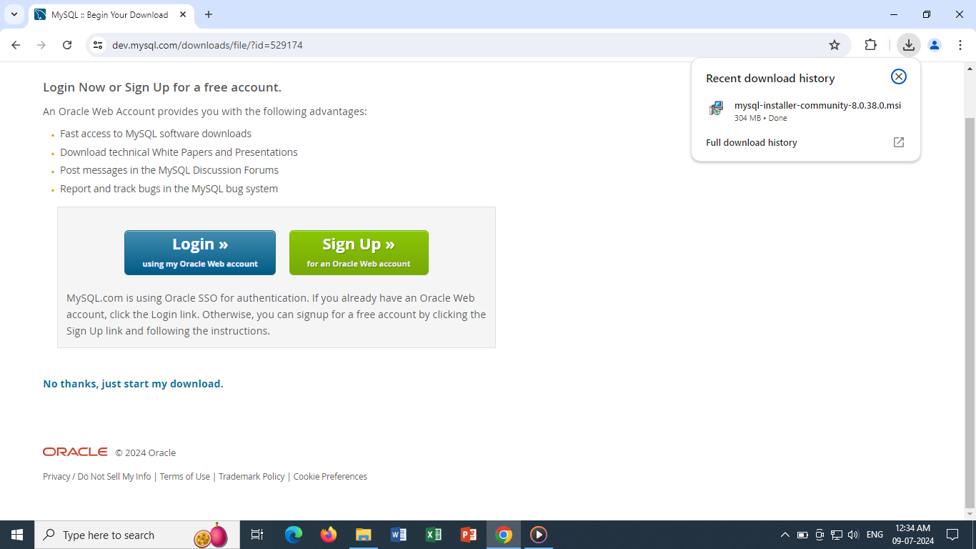
There is no need to login or sign-up, directly start with the download.
Once the download is completed, Click on it to start installation process.

Slide 8
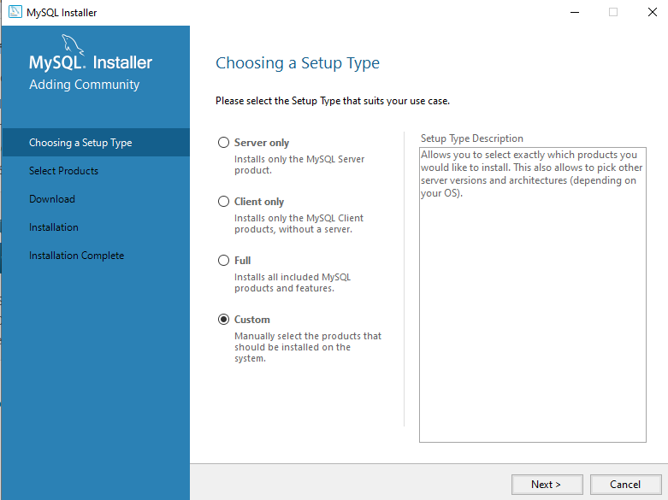
After starting the installation process, you will get windows popup to allow to make changes, click it as YES. Then Set setup type as CUSTOM as we need to select which products we need. And NEXT

Slide 9
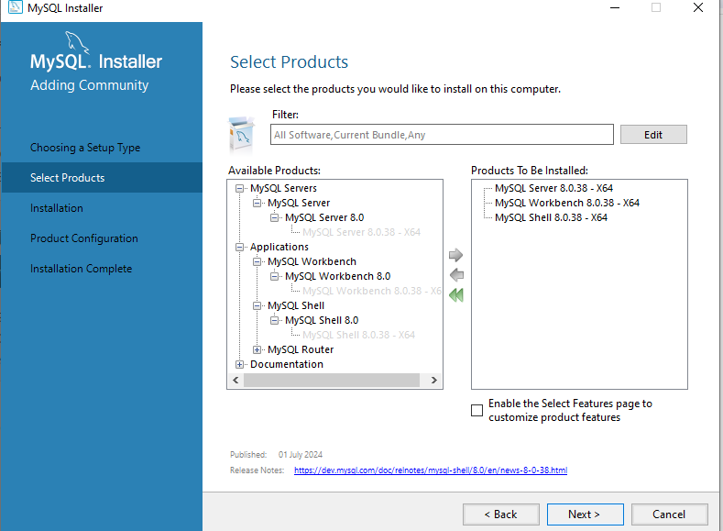
Now you need to select the products.
Expand the options and select server, workbench and shell. Select each product and click on right arrow to move the product in right empty space. And NEXT

Slide 10
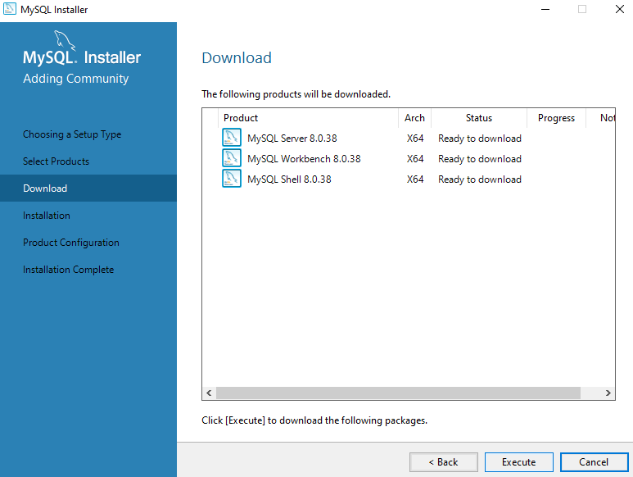
To download selected products on device, click on EXECUTE.
After getting the status as complete and green symbol, click on NEXT

Slide 11
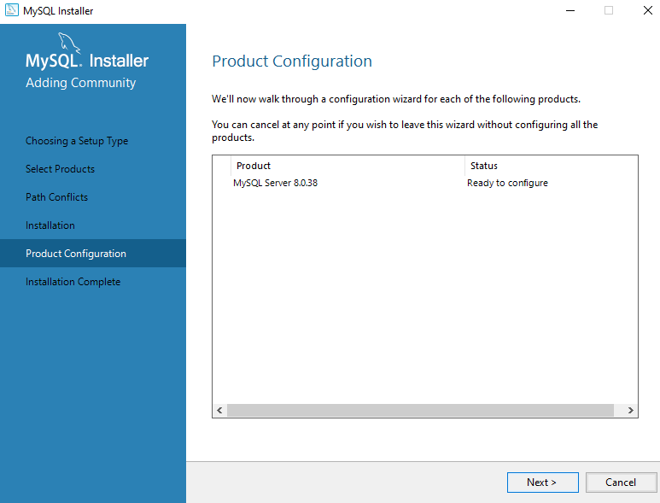
click NEXT for product configuration

Slide 12
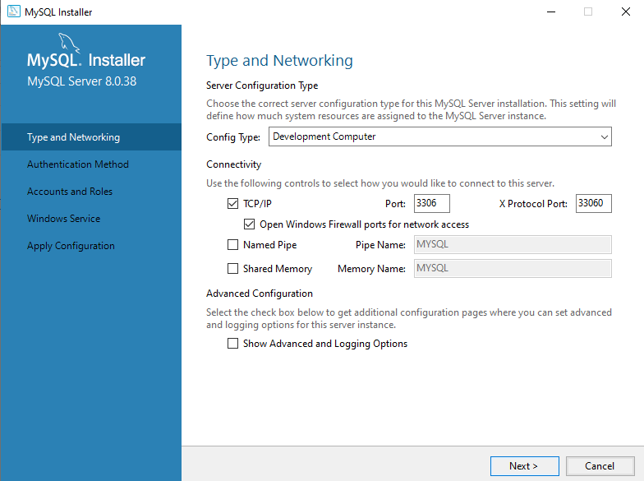
On type and networking, nothing to change just have a look and click NEXT

Slide 13
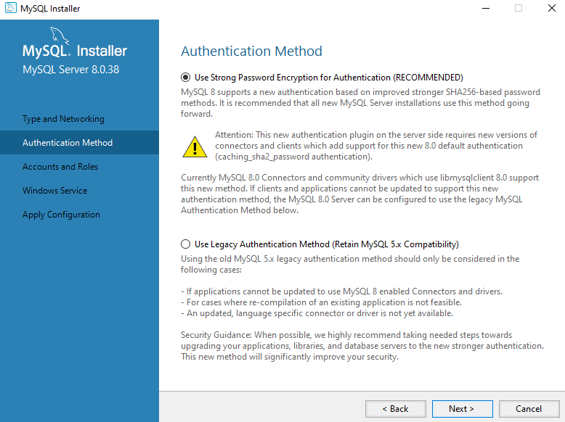
By default, strong password is selected as Authentication method. Keep it as it is and NEXT

Slide 14
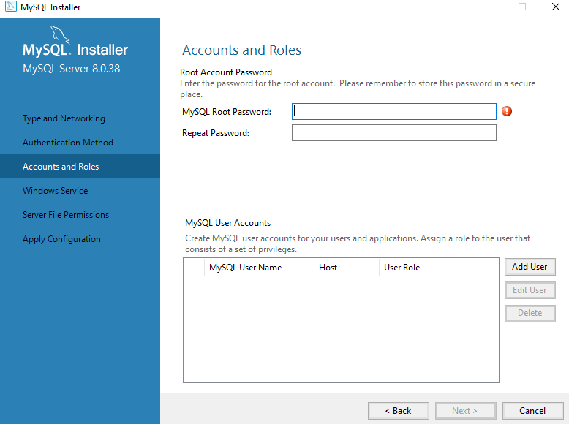
Enter your password and remember it to login further.
Don’t add any user and NEXT

Slide 15
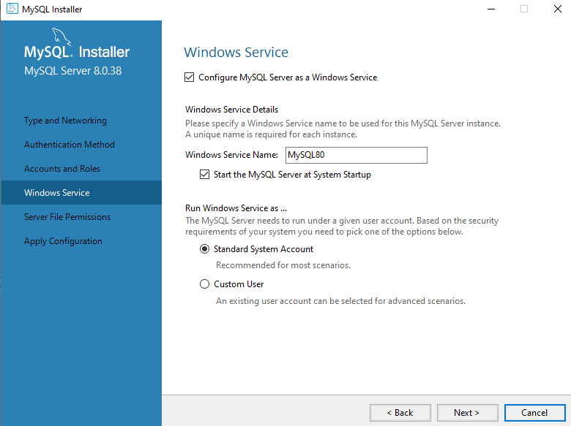
Click NEXT

Slide 16
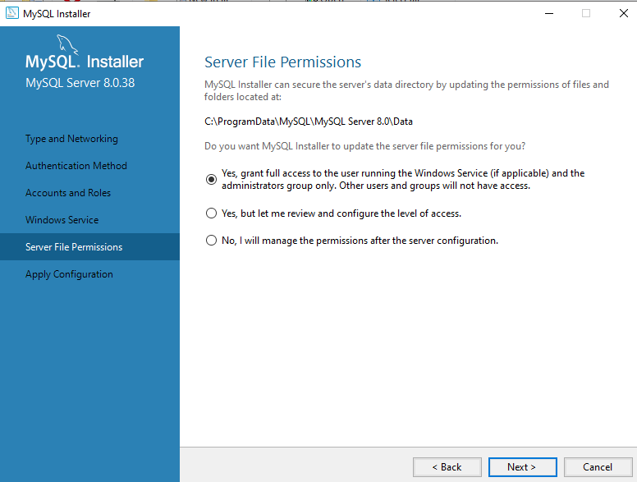
Here is the location path, where all your data from workbench will be stored. You can take a backup from this path when you need. Click NEXT

Slide 17

Click on EXECUTE. When all the circles are filled with green tick click FINISH.

Slide 18
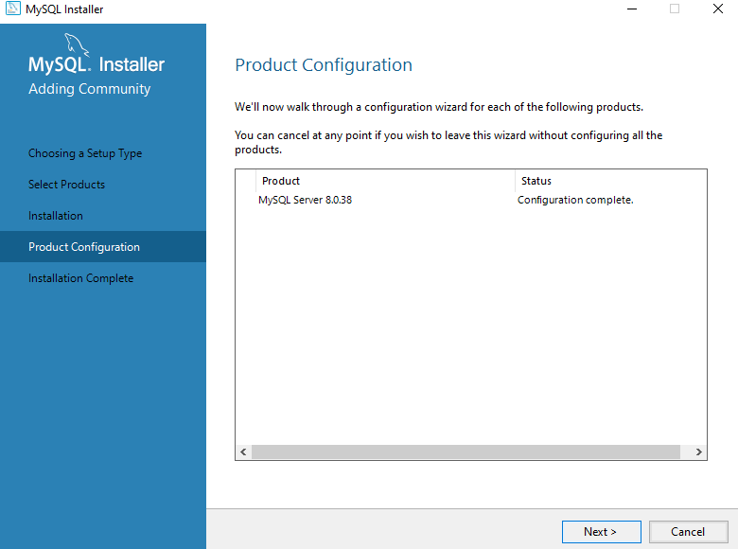
Here the product configuration is completed. Click NEXT

Slide 19
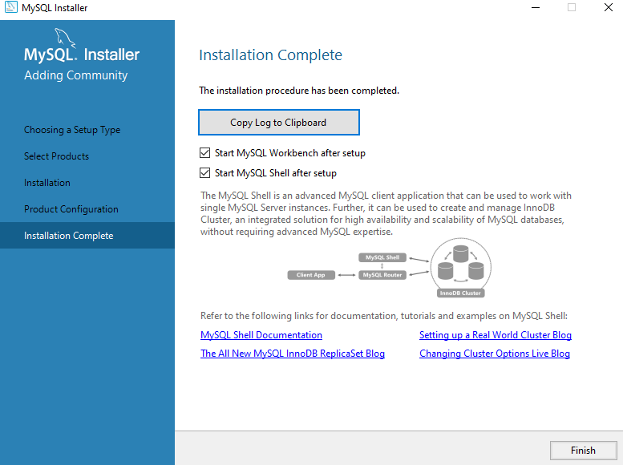
Finally the installation is completed. Click FINISH

Slide 20
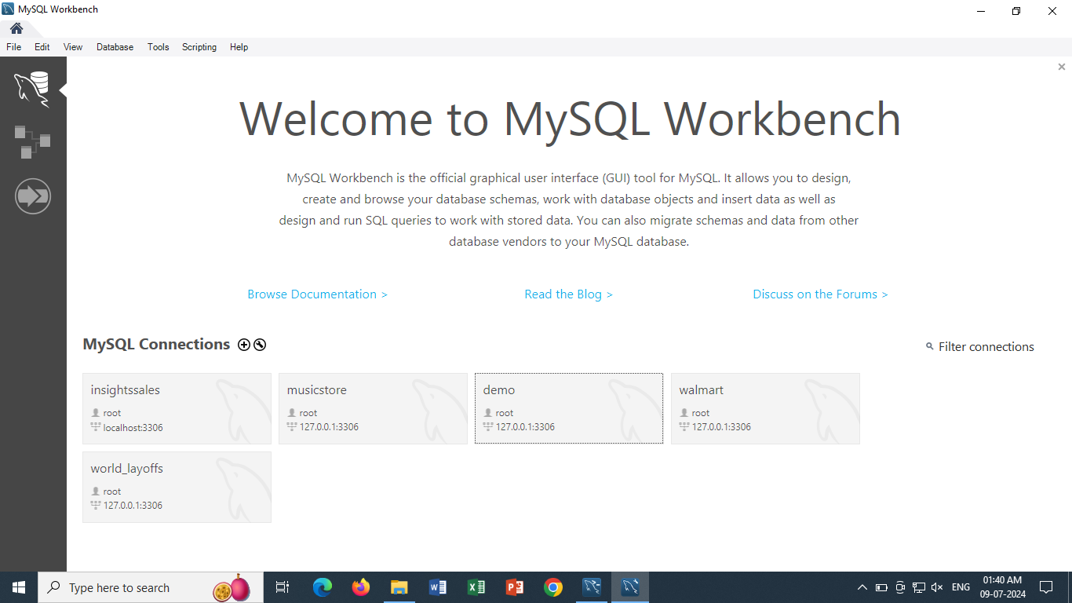
This is the welcome screen of MySQL Workbench, which opens automatically after installation.
As a new user, you will see only one connection on your screen by default.

Slide 21
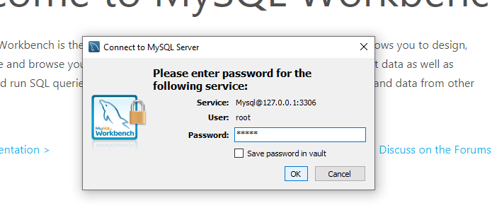
Select the by default connection you see on your screen and popup comes to enter the password.
Enter your password that you set during installation process, tick to save it so you don’t need to enter password every time you open workbench. And OK

Slide 22
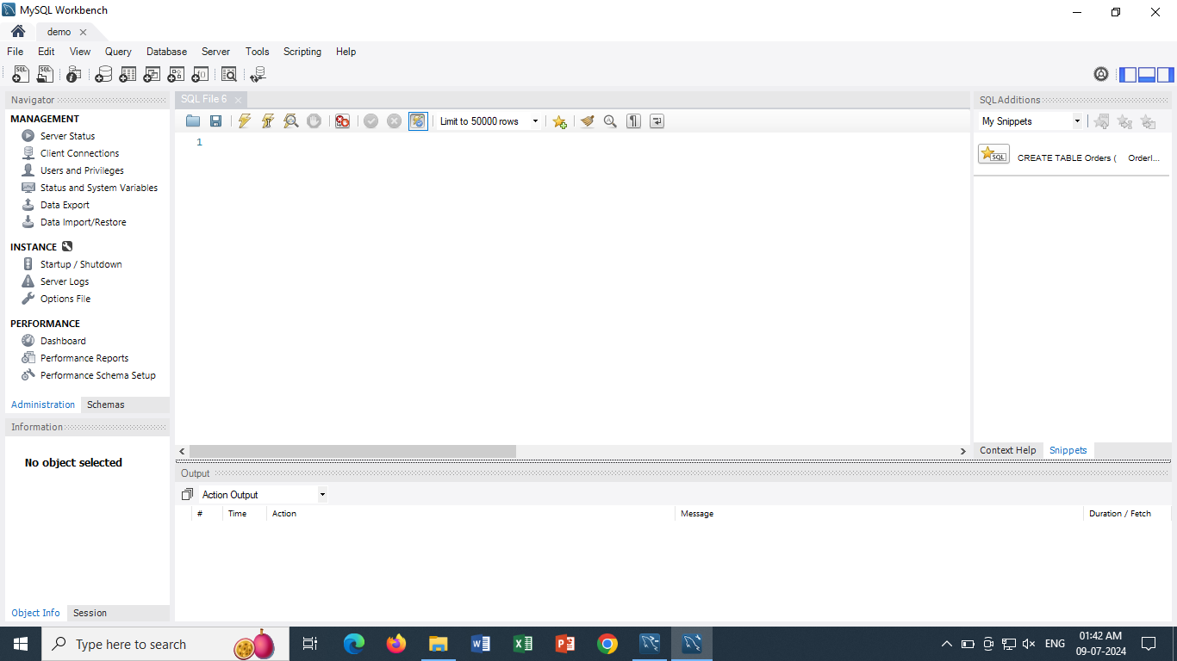
This is the overview of your MySQL workbench editor, place where you will perform queries.

Slide 23
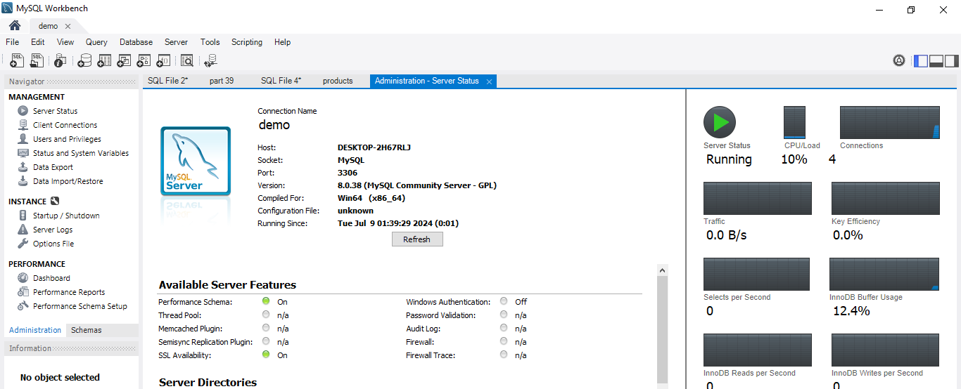
To check whether your installation is done properly or server is connected, go to Administration → server status → see whether the status is running

Slide 24
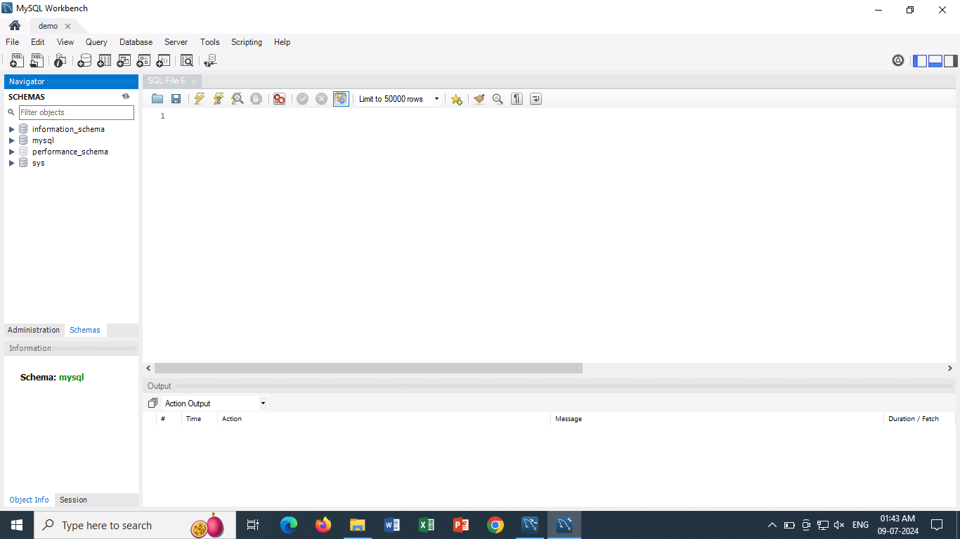
Overview of MySql Workbench
5
1
3
2
4

Slide 25
Sections of MySql
Section where your Databases and tables are displayed
Section where information of selected table is displayed
Section where you perform queries
Section where the output status of queries are displayed
You can turn on/off any section as per need.

Slide 26
PART 2
OVERVIEW

Slide 27
INTRO
SQL is a tool for organizing, managing, and retrieving data stored by a computer database which is extensively used from last 40 years.
The name "SQL" is an abbreviation for Structured Query Language.
For historical reasons, SQL is usually pronounced "sequel," but the alternate pronunciation "S.Q.L." is also used.
As the name implies, SQL is a computer language that you use to interact with a database. In fact, SQL works with one specific type of database, called a relational database.
When you need to retrieve data from a database, you use the SQL language to make the request. The DBMS processes the SQL request, retrieves the requested data, and returns it to you. This process of requesting data from a database and receiving back the results is called a database query—hence the name Structured Query Language.
SQL statements look like simple English sentences, making SQL easy to learn and understand.

Slide 28
WHY IS IT CALLED STRUCTURED QUERY LANGUAGE?
The data is stored in proper structured format, that is tabular form which consist of rows and columns.
For Eg– see below STUDENT table--
StudentID | Name | Age | Gender
1 | Ram | 21 | Male
2 | Sana | 27 | Female
3 | John | 25 | Male
Column / Attribute / Field
Column is a place where we store one detail of all the people with similar data of same data type.
Row / Instance / Record
Row stores all the details of particular information.

Slide 29
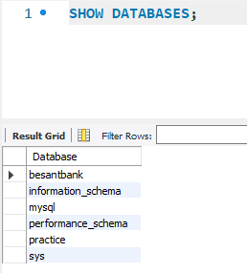
LIST OF DATABASE
As a new user, you will see only highlighted 4 databases.
Information_schema ---- this database stores all the details of all the tables.
Mysql ---- contains things provided by the SQL
Performance_schema ---- this database works on storage alert
Sys ---- this database is a collection of functions, stored procedures and views that provides access to performance schema.
Other databases are which you create on your requirement.

Slide 30
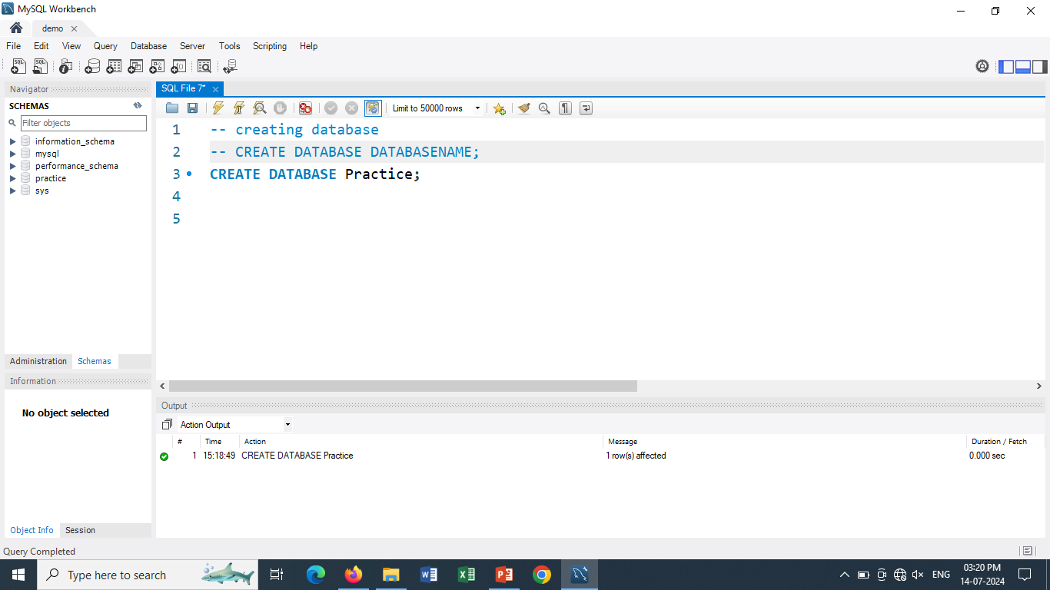
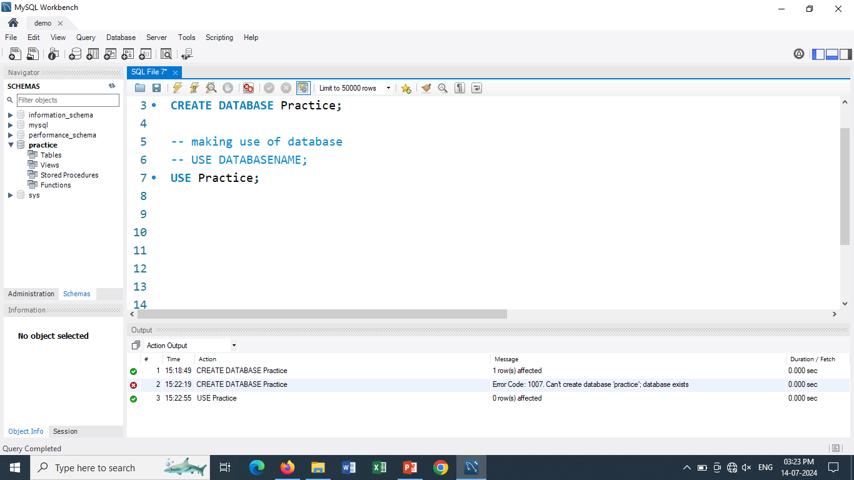
CREATE AND USE DATABASE
Create database to store various data.
Then click on refresh icon so that database is displayed in schema section
(NOTE– always end your query with “;” else it will show error.
While executing query, place your cursor on the statement and press “CTRL + ENTER”.
Sometimes there are cases that you will forget the logic behind the query, comment those queries.)
There are multiple databases present. System should know which database to use so run use database query.
You can see the database gets highlighted.

Slide 31
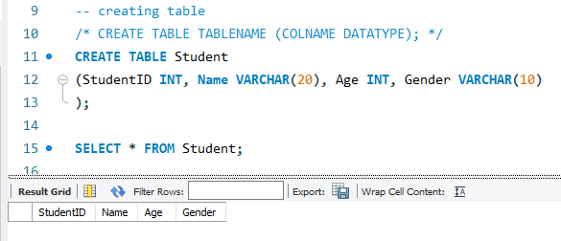
CREATE TABLE
Before you can store data in a database, you must first define the structure of the data.
This SQL CREATE TABLE statement defines a new table to store the data.

Slide 32
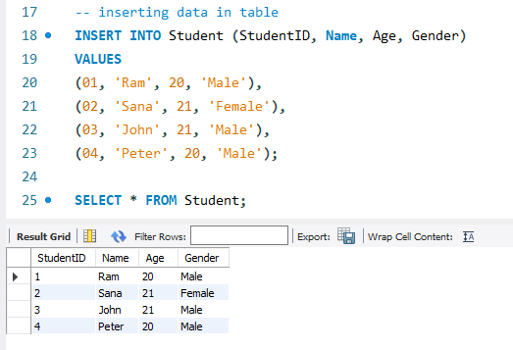
ADDING DATA TO THE TABLE
SQL is also used to add new data to the table.

Slide 33

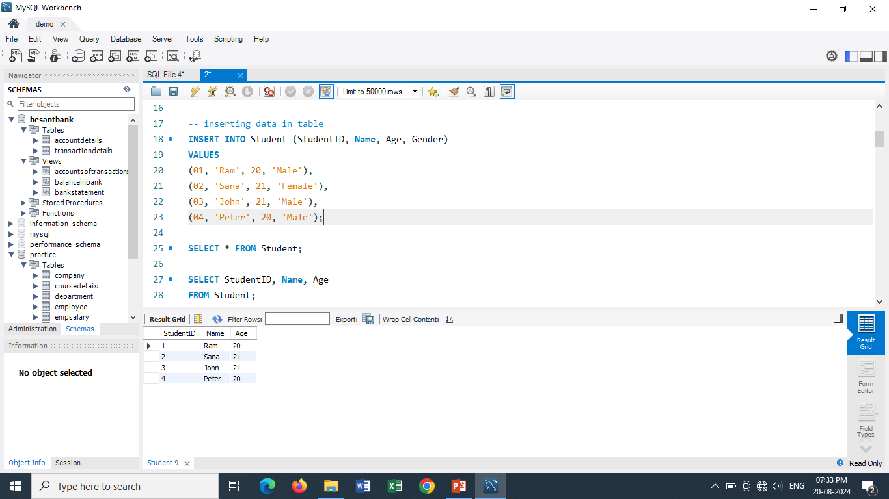
RETRIEVING DATA
The SQL statement that retrieves data from the table is called SELECT.
The results of the query appear, in tabular form, immediately after the request.

Slide 34
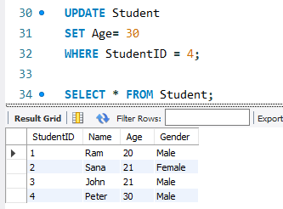
UPDATING THE TABLE
The SQL language is also used to modify data that is already stored in the table

Slide 35
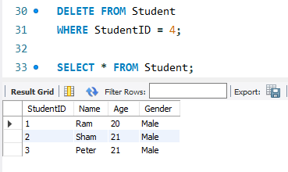
DELETING DATA
Just as the SQL INSERT statement adds new data to the Table, the SQL DELETE statement removes specified data from the Table.

Slide 36
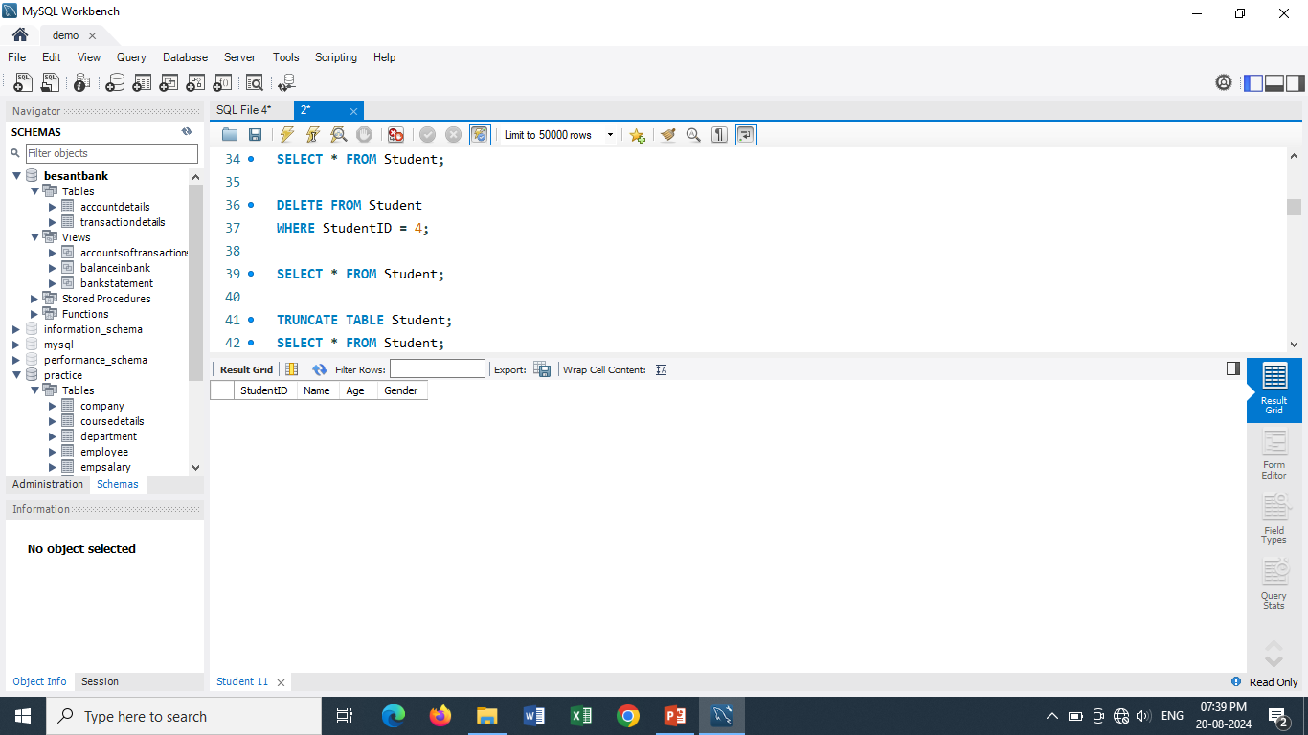
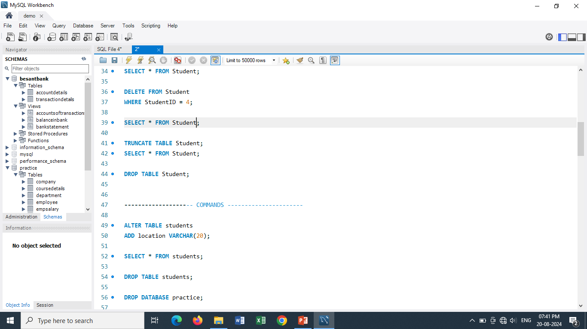
EMPTY AND DELETE THE TABLE
If you discover later that you no longer need to store the data in the database, you can erase the data from table(keeping the structure as it is) or remove the table(and all of the data it contains) with the DROP and TRUNCATE.
TRUNCATE deletes all the records from the table but structure of table remains as it is.
DROP deletes everything- records as well as table structure.

Slide 37
WHAT IS DATA?
Data refers to any information or facts that can be recorded, stored, and processed in a tabular form.
It can be in various forms, such as text, numbers, images, audio, or video.
Examples of data include customer names, product prices, temperature readings, and more
Student Table
In short, Information that is stored in this tabular form is called DATA.
We store it in tabular form for future references, the way to store contact details in our mobiles so that in future when there is need we can call particular person.
This data is stored in any physical format like harddisk, server, etc.
StudentID | Name | Age | Gender
1 | Ram | 20 | Male
2 | Sana | 21 | Female
3 | John | 21 | Male
4 | Peter | 30 | Male

Slide 38
WHAT IS DATABASE?
A database is a structured collection of data that is organized for efficient storage, retrieval, and management.
It provides a way to store and manage large amounts of data in a systematic manner.
Databases can be relational (using tables) or non-relational (using other data models).
Database is a storage container where we can
create tables,
insert data in tables,
update/modify existing data in a table,
delete data/table.

Slide 39
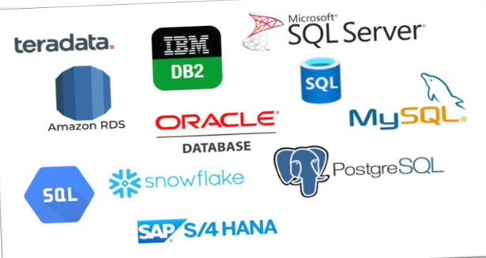
A DBMS(DATABASE MANAGEMENT SYSTEM) is software that allows users to interact with databases.
It provides tools for creating, modifying, querying, and maintaining databases.
Examples of DBMS include →

Slide 40
PART 3
DATA TYPES

Slide 41
Data type of a column defines what value the column can store in table.
Data types are defined while creating tables in database.
Data types are mainly classified into three categories
• Text: char, varchar
• Numeric: integer , fractional values
• Date and time: date, time, datetime

Slide 42
Text Data Type
Text Data Type has 3 sub-types—
Char
Varchar
Text
CHAR-- Fixed-length character text and it is updating its column regularly.
Eg- Name char(10);
Name is Ram. Ram is 3 character long but it will take all 10 characters in char.
VARCHAR - Variable-length character and it is non updating also saves storage.
Eg- Name varchar(10);
Name is Ram. Ram is 3 character long, so varchar will take only 3 characters and not 10 characters.
TEXT- Large text data. It can even store a book.
5

Slide 43
Numeric Data Type
Numeric Data Type has 2 sub-types—
Integer
Fractional values
INTEGER- stores whole numbers
Integer includes types like TINYINT(255), SMALLINT(32K), INT(200CR), BIGINT(2⁶⁴⁻¹)
FRACTIONAL VALUES – stores decimal, float etc numbers
it includes FLOAT(16digits), DOUBLE(32digits), DECIMAL(32 digits)

Slide 44
Date & Time Data Type
Date & Time Data Type has 3 sub-types—
Date
Time
Date Time
DATE stores date in single quotation
it has format like “YYYY-MM-DD”
TIME– stores time of the day
it includes format like “HH:MM:SS”
DATETIME- stores date and time together
it includes format like “YYYY-MM-DD HH:MM:SS”

Slide 45
PART 4
COMMANDS

Slide 46
Commands are useful to communicate with database.
There are 5 types of SQL Command Languages
DDL (Data Definition Language)
DML (Data Manipulation Language)
DQL (Data Query Language)
TCL (Transaction Control Language)
DCL (Data Control Language)
DDL | DML | DQL | TCL | DCL
Create | Insert | Select | Commit | Grant
Alter | Update |  | Roll back | Revoke
Drop | Delete |  | Save point
Truncate
Rename

Slide 47
DDL
It is used to create and modify the structure of database objects in the database and only works with descriptions of the database schema.
Although data cannot be created, modified, or deleted with DDL, database structures can.
Create the database or its objects.
CREATE DATABASE database_name
CREATE TABLE table_name (
column1 datatype,...);
Create
ALTER TABLE table_name ADD column_name datatype;
ALTER TABLE table_name DROP COLUMN column_name;
ALTER TABLE table_name MODIFY column_name datatype;
Alter
This is used to change the database’s
structure
Drop
Use the DROP command to remove
objects from the database.
DROP DATABASE database_name;
DROP TABLE table_name;
Truncate
Used to eliminate every record from
a table
TRUNCATE TABLE table_name;

Slide 48
DML
SQL statements are part of the DML which is used to manipulate data that is present in data-
bases.
It is part of the SQL statement in charge of managing database and data access.
Insert
Data inserted into a table .
INSERT INTO table_name (column1, column2,..)
VALUES (value1, value2,..);
UPDATE table_name
SET column1 = new_value1
WHERE condition;
Update
Table existing data is updated
Delete
Delete records from a database
table
DELETE FROM table_name
WHERE condition;

Slide 49
DQL
DQL is a sublanguage of SQL that is used to query data from a database.
It is a declarative language, which means that you tell the database what you want, not how to
get it.
DQL statements are made up of keywords, operators, and values.
Some common DQL keywords include SELECT, FROM, WHERE, and ORDER BY
There are two types of inserting data—
Implicit inserting – inserting data for all columns present in a table.
Explicit inserting – inserting data only in a specific column
SELECT *
FROM customers;
SELECT *
FROM customer_orders
WHERE customer_id = 100;
Retrieves data from one or
more tables.
Select

Slide 50
TCL
SQL statements are part of the DML which is used to manipulate data that is present in data-
bases.
It is part of the SQL statement in charge of managing database and data access.
Commit
Save changes made during transactions
( queries… )
COMMIT;
Roll-Back
(query)
ROLLBACK;
Revert changes if any error occurs.
A point within a transaction where
you can roll back to a specific state
without affecting the entire
transaction.
Save Point
(query)
SAVEPOINT A;
ROLLBACK to A;

Slide 51
DCL
SQL statements are part of the DML which is used to manipulate data that is present in data-
bases. This is used by administrator side and not developers.
It is part of the SQL statement in charge of managing database and data access.
Grant
Grants specific privileges to user.
GRANT SELECT ON (table’s name)
FOR user@servername;
Revoke
Removes privileges from user.
REVOKE SELECT ON (table’s name)
FROM user@servername;

Slide 52
PRACTICAL IMPLEMENTATION

Slide 53
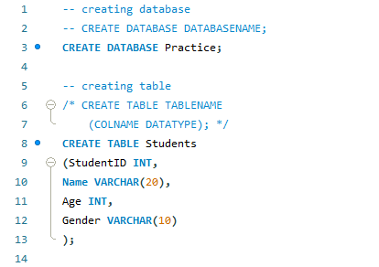
CREATE

Slide 54
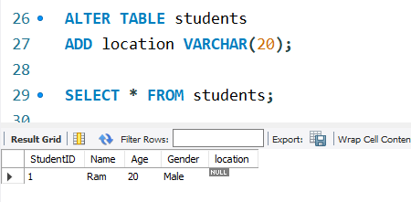
ALTER

Slide 55
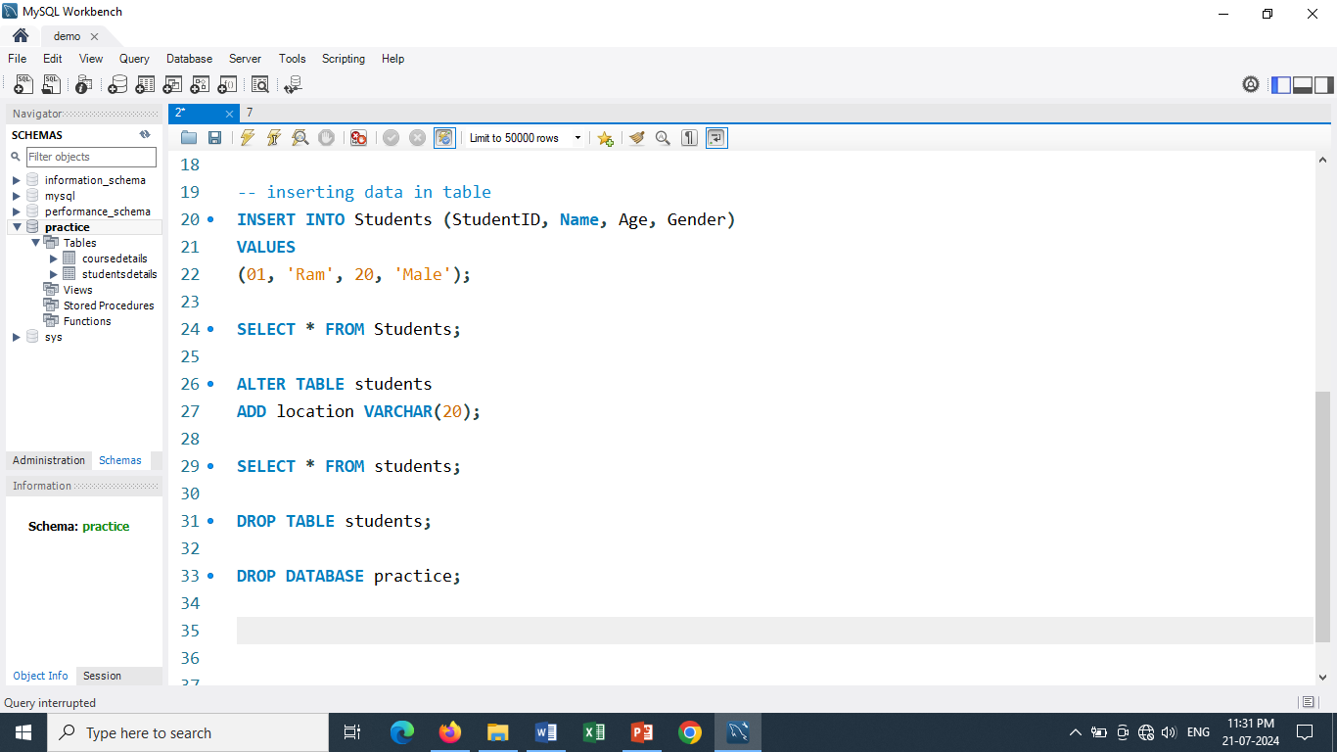
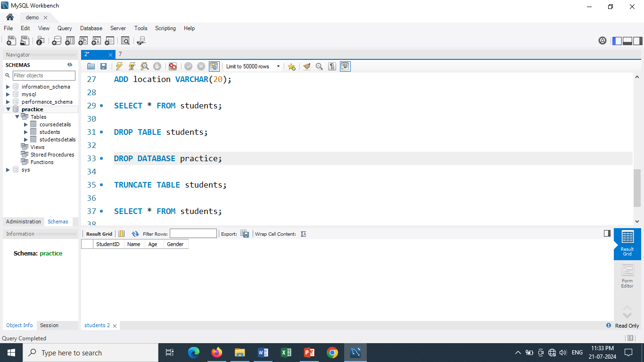
DROP
TRUNCATE

Slide 56
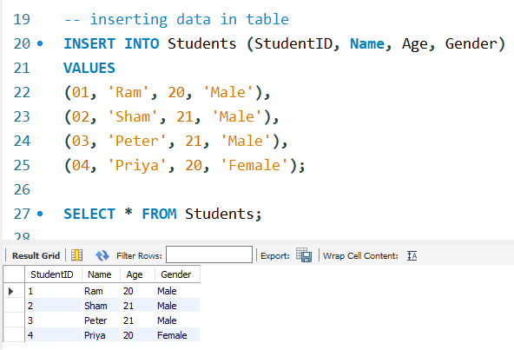
INSERT

Slide 57
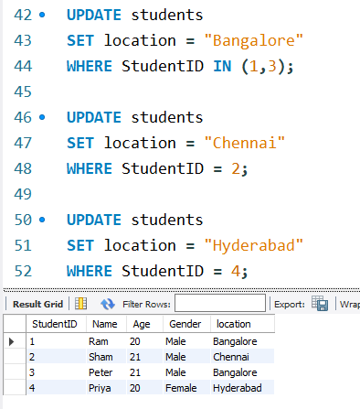
UPDATE

Slide 58
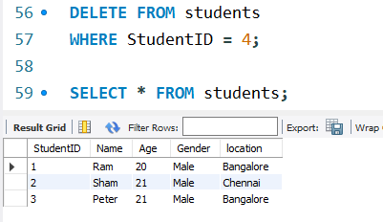
DELETE

Slide 59
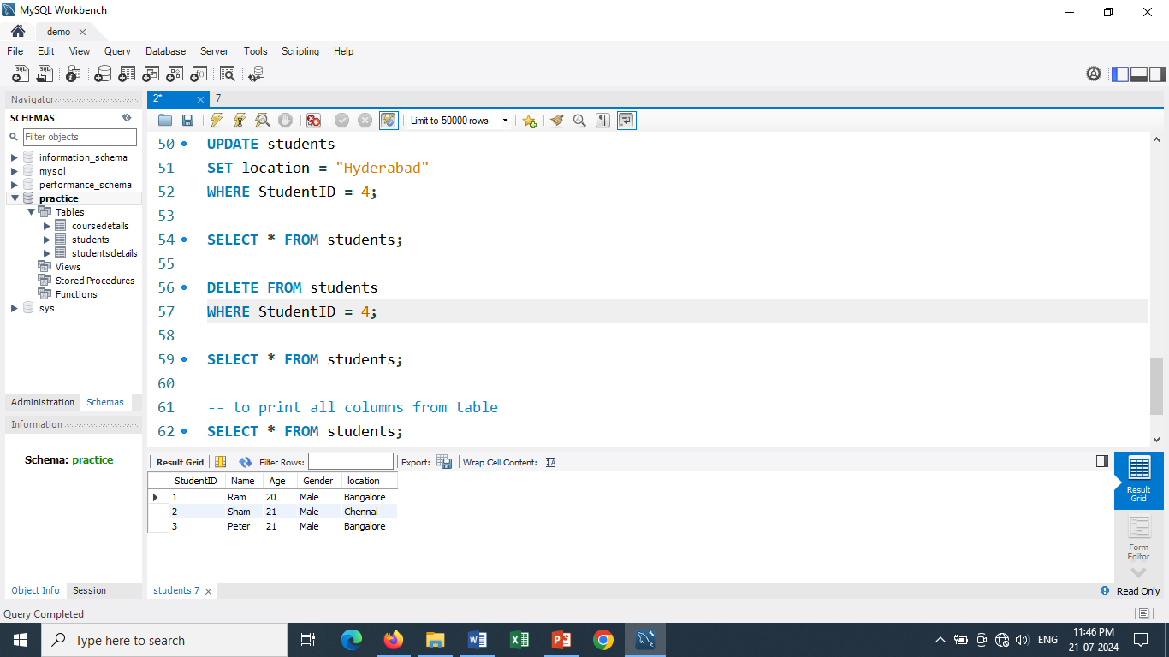
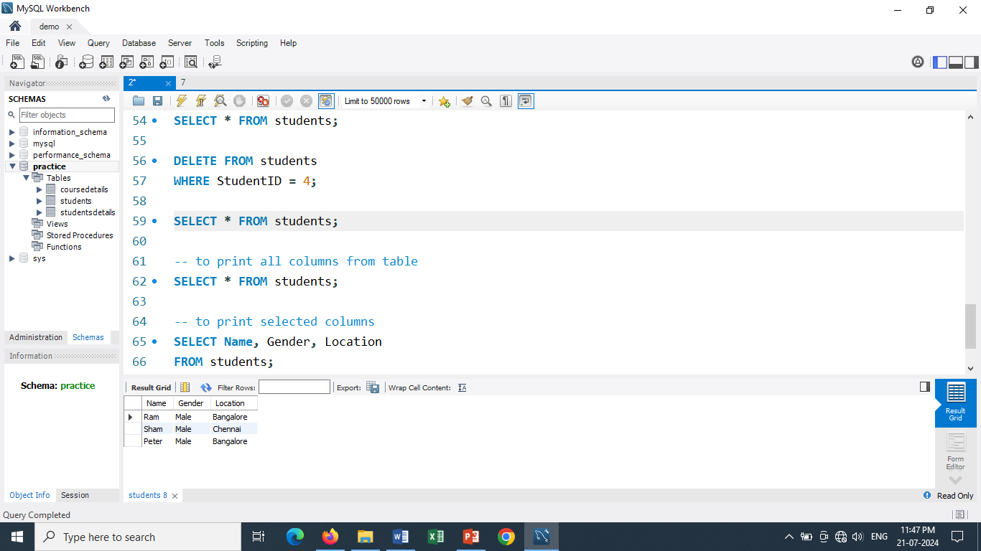
SELECT

Slide 60
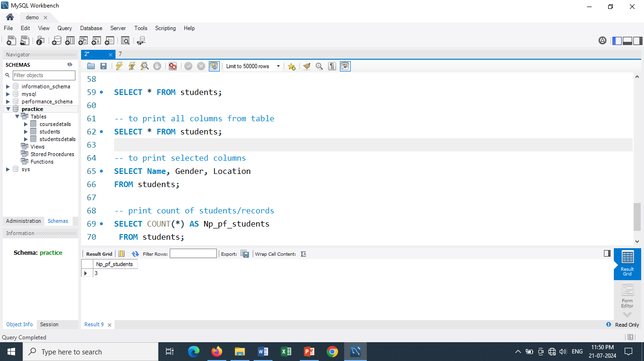

SELECT

Slide 61
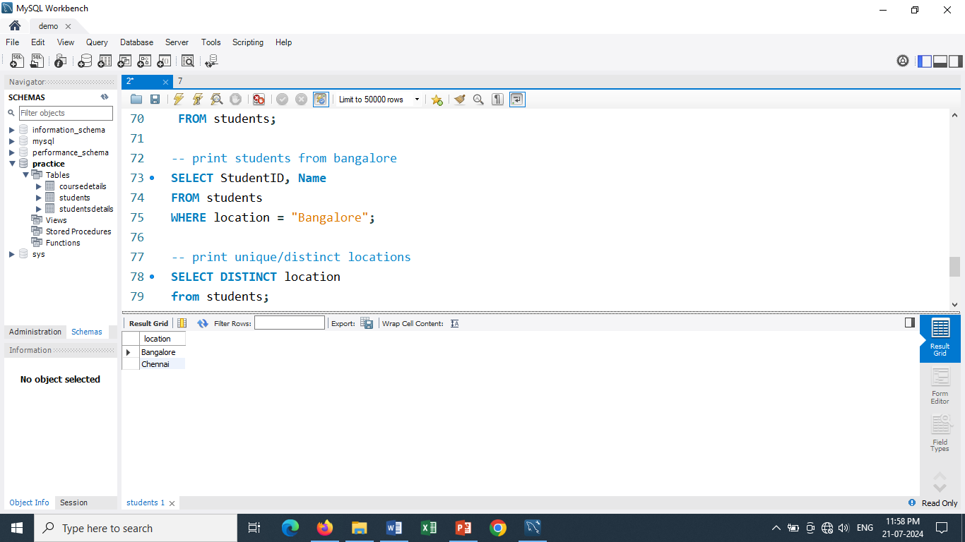
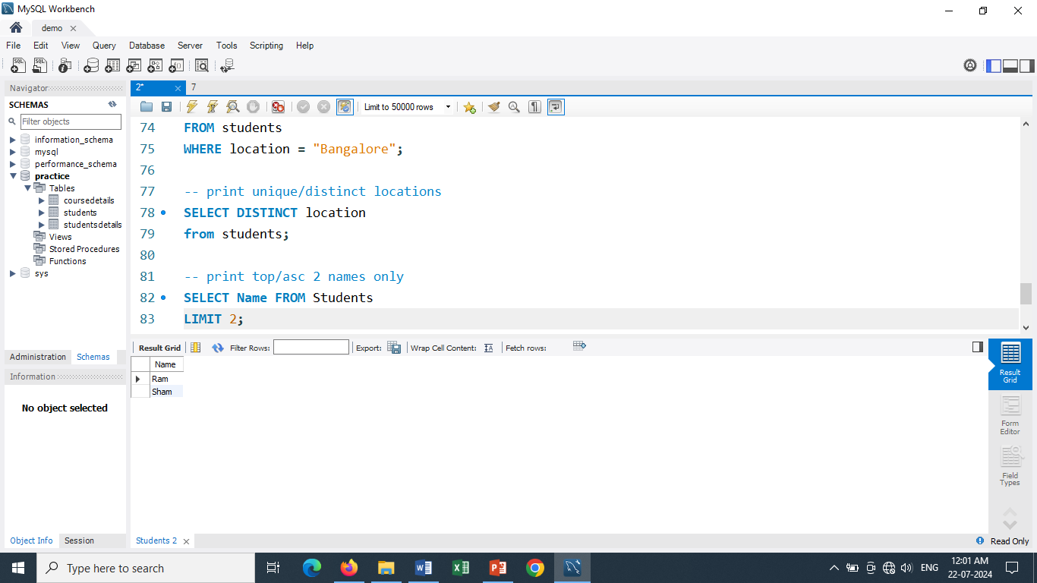
SELECT

Slide 62
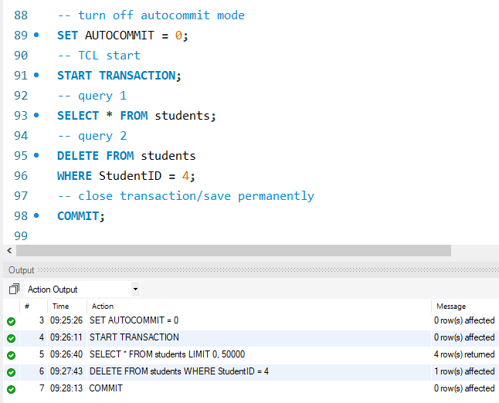
COMMIT

Slide 63
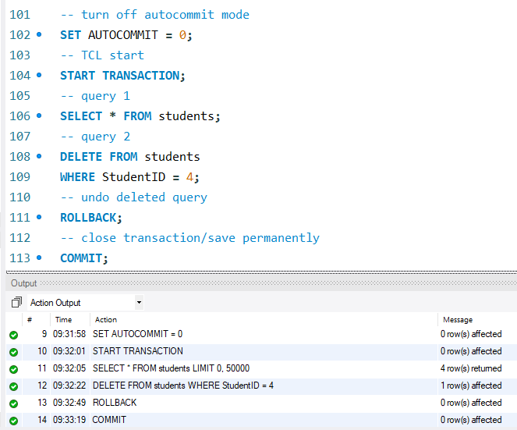
ROLLBACK

Slide 64
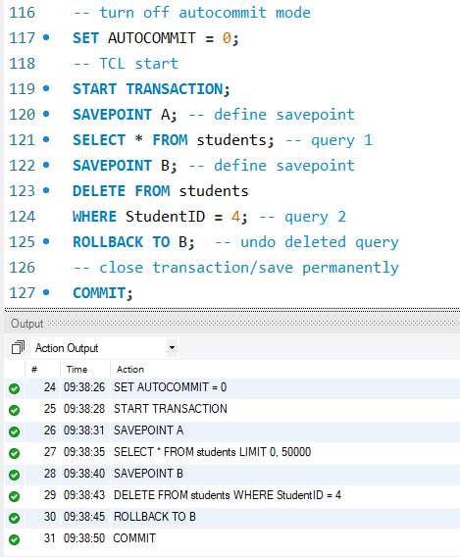
SAVEPOINT

Slide 65
PART 5
CONSTRAINTS

Slide 66
Constraints are used to specify rules for data in a table. This ensures the accuracy and reliability of the data in the table.
Constraints can be specified when the table is created with the CREATE TABLE statement, or after the table is created with the ALTER TABLE statement.
There are two types of constraints—
Regular Constraints | Key Constraints
Null By setting NOT NULL to the col, no null value will be accepted, value will be mandatory to enter | Unique Value that is not duplicated but can have only one null value
2. Default If the col contains only one value throughout the table, you can set the value as default value so it gets automatically entered. | 2. Primary key (Parent value) The primary key can be used to uniquely identify the rows of a table. Only one primary key is allowed per table. No duplicates / null values
Check It works based on given condition for specific column | 3. Foreign key (child value) Foreign Keys constraints ensure data integrity, by enforcing that values in one table must match values in another table.
 | 4. Auto_increment(PK/Unique) Sequence of values one after another.

Slide 67
Normalization
The process of splitting one big table in multiple small tables is called normalization.
The purpose of normalization is
To save storage
To make application work smoother and faster
To increase performance
To decrease data ETL process

Slide 68
Before Normalization
SID | NAME | AGE | CID | CNAME | AMOUNT
1 | Ram | 21 | 1 | SQL | 15000
2 | John | 22 | 1 | SQL | 15000
3 | Sana | 23 | 2 | Power-BI | 12000
Studentsdetails
Table
After Normalization
CID | CNAME | AMOUNT
1 | SQL | 15000
2 | Power-BI | 12000
Coursedetails
Table
SID | NAME | AGE | CID
1 | Ram | 21 | 1
2 | John | 22 | 1
3 | Sana | 23 | 2
Studentsdetails
Table

Slide 69
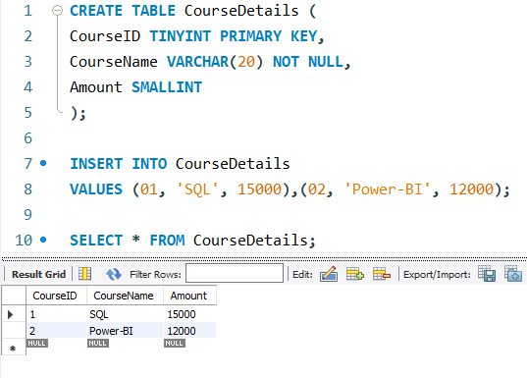

Slide 70



Slide 71
PART 6
ORDER OF QUERY
WRITING

Slide 72
While writing SQL queries, there is order to be followed.
SELECT → FROM → WHERE → GROUP BY → HAVING → ORDER BY → LIMIT
SELECT column names
FROM table name
WHERE condition (filter the data)
GROUP BY column name (grouping the column- columns mention in groupby should be written in SELECT)
HAVING condition (similar to where– filter data of aggregated column)
ORDER BY column name ASC/DESC (sort by ascending/descending)
LIMIT ;(top/bottom nth record)

Slide 73

Sales table

Slide 74

Highlighted shows order of writing query

Slide 75
ORDER OF EXECUTING QUERY
1. FROM Sales: The system starts by fetching data from the `Sales` table.
2. WHERE OrderDate BETWEEN '2023-01-01' AND '2023-12-31': It then filters the rows to include only those with `OrderDate` in 2023.
3. GROUP BY ProductID: The filtered data is grouped by `ProductID`. Each group represents a unique `ProductID`.
4. HAVING SUM(Quantity) > 100: After grouping, the `HAVING` clause filters out groups where the total quantity (`SUM(Quantity)`) is 100 or less.
5. SELECT ProductID, SUM(Quantity) AS TotalQuantity, COUNT(*) AS NumberOfOrders: The `SELECT` clause specifies the columns to be included in the result. Here, it includes `ProductID`, `SUM(Quantity)` as `TotalQuantity`, and `COUNT(*)` as `NumberOfOrders`.
6. ORDER BY TotalQuantity DESC: The results are sorted by `TotalQuantity` in descending order.
7. LIMIT 7: Finally, the `LIMIT` clause restricts the output to the top 7 rows based on the sorting order.

Slide 76
PART 7
SAMPLE TABLES

Slide 77


Slide 78



Slide 79


Slide 80


Slide 81
PART 8
JOINS

Slide 82
Cardinality
Cardinality means relationship between two tables.
There are three types of relationships—
1 – 1 → one value from table1 matched with one value from table 2
1 -- * → one value from table1 matched with multiple values from table 2
* -- * → multiple values from table1 matched with multiple values from table 2
(1 → one, * → many)

Slide 83
Joins
Joins are used to retrieve data from multiple tables.
Join is a method of combining information from two tables.
There are mainly two types of Joins—
Inner join (matching values)
Outer join (matching + unmatching values)
Left outer join
Right outer join
Full outer join
Cross join
Self join
Syntax—
SELECT colnames,..,..
FROM table1 AS t1
JOIN table2 AS t2
ON condition;

Slide 84
Inner Join
Returns records that have matching values in both tables
Left Outer Join
Returns all records from the left table, and the matched records from the right table
Right Outer Join
Returns all records from the right table, and the matched records from the left table
Full Outer Join
Returns all records when there is a match in either left or right table

Slide 85
Cross Join
A CROSS JOIN returns the Cartesian product of the two tables, meaning it combines every row from the first table with every row from the second table.
Self Join
A self join is a special type of join where a table is joined with itself.
This is useful when you have hierarchical data or need to compare rows within the same table

Slide 86


SAMPLE TABLES

Slide 87



Slide 88


Slide 89


Slide 90


Slide 91

UNION is used to combine the results of two or more SELECT statements into a single result set. It removes duplicate rows by default.
UNION gives following output--
UNION ALL is similar to UNION, but it retains duplicate rows from the combined result sets.
UNION ALL gives following output--

Slide 92


Slide 93



Self Join
Company table

Slide 94
PART 9
SUBQUERY

Slide 95
Query within another query is called SUBQUERY.
Innermost query is executed first then the outer query.
Basically it works from IN to OUT.
Subquery is used to print data from table one while depending on table two.
Subquery can be used in WHERE and HAVING clause.
Scenario of using subquery is when there is table dependency.

Slide 96

In Accountdetails table, there is already one record.
Add more 10 records.

Slide 97

In Transactiondetails table, there are already 2 record.
Add more 1 record.

Slide 98

Que-- Write query to get the Account details of peoples who did transactions
STEP 1– finding AccountID of peoples who did transaction

Slide 99

STEP 2 – getting details of STEP1 peoples
Here, if you have like 1CR records it is not possible to give all those AccountID in query like (1,7).
So for this subquery concept is used to dynamically calculate AccountID (check STEP 3)

Slide 100

STEP 3– Combining STEP 1 and STEP2 as a subquery to create dynamic query
In STEP2, AccountID are given manually while in STEP3 AccountID are given dynamically.
Both steps has same output.

Slide 101
PART 10
DERIVED TABLE

Slide 102
Derived table concept is like sub-query.
Derived table is used in SELECT and FROM class.
In where and having clause (subquery), LIMIT,IN,ALL,ANY are not supported, so for this Derived table is used.
Output of Inner query is saved as Temporary table which is then executed from outer query.

Slide 103

Que- Write a query to find 5th highest balance
STEP 1– finding top 5 balances
1st
2nd
3rd
4th
5th

Slide 104

STEP 2– find top 5th balance - subquery
Here, subquery concept is used.
This query gives error as It doesn’t support LIMIT, IN in WHERE clause.
So you can use Derived table concept.(step 3)

Slide 105

STEP 3– finding top 5th balance- derived table
Here, inner query is executed within FROM class which supports LIMIT.
Topbalance is called Temparory table.
Inner query is saved as temparory table which gets executed from outer query

Slide 106

Que- Write a query to find 2nd highest balance

Slide 107
PART 11
VIEWS

Slide 108
When you need to use same one query everyday, SQL provides the database to store these queries separately. It is called query storing.
One of the query storing is VIEWS
VIEW is a database object used to store single select query.
There are two types of views
Updatable views – data updated in view, also gets updated in base original table
Un-updatable views – cannot update view when used any aggregate functions, joins
Limitations—
Store only single select query
Cannot store update/delete query inside view but can store on view
No parameters allowed
No variables allowed
No programming allowed
Syntax—
CREATE VIEW viewname AS
(query)

Slide 109

Que-- Create a view to get the account details of people who did transactions.
STEP 1 – Create view
Refresh after executing view to check created view.

Slide 110

STEP 2– run view
You can execute view using select statement or
Simply click on last icon besides view name

Slide 111

Insert one record in Transactiondetails table and execute view to check if newly inserted record is visible in view
Newly inserted record of AccountID 2 in visible in view.
Here, person details from Accountdetails table are visible who gets added in Transactiondetails table, but currentbalance column doesn’t get updated as per transactions done.
To update currentbalance column, Triggers concept is used.

Slide 112


UPDATABLE VIEW
Record updated in view (Ram to Ram Prasad) is also updated automatically in base table that is Accountdetails table.

Slide 113


UN-UPDATABLE VIEW
Here it is not possible to update record.
It gives error.

Slide 114
PART 12
STORED PROCEDURES

Slide 115
Stored procedure is a database object used to store complete process using multiple queries.
Stored procedure can store multiple select queries also update/delete queries are allowed.
Even parameters, variables and programming is allowed in stored procedure.
Parameter is a storage container that store single value of specified data type
Parameter is given as a input value during execution which is filtered to get the desired output.
Variable store output of a select query.
It also stores single value off specified data type.
Here programming means IF…ELSE conditions, loops and some functions.

Slide 116

Que-- Write a query to print all the transaction details of AccountID 1
This is simple view created for AccountID 1.
When you have 1CR of records, it is impossible to create view for every AccountID.
During such time, STORED PROCEDURE concept is used to create it dynamically.

Slide 117

To create stored procedure, Right-click on Stored Procedures → create stored procedure

Slide 118

Give a name of procedure, in brackets define parameter of the input value with datatype and write query between BEGIN and END. Then Apply ➔ Apply → Finish

Slide 119



Refresh your schema and check for stored procedure.
Hover on created procedure and click on execute icon, you get a popup to input value.
Enter the AccountID and execute, you get your output in tabular form
To edit query, click on first icon.

Slide 120
Que-- Using Stored Procedure, create a Bank Mini Statement as shown
DateTime AccountID Name ….. (statements of 6month) ….. Current Balance

Slide 121


Slide 122


On popup box, enter AccountID present in Accountdetails table.
on executing you get output in different tabs as per each select query.
To get all results in one tab,
Press CTRL + ALT + ENTER

Slide 123



Slide 124


Enter AccountID not present in Accountdetails table.
on executing you get output as
Invalid AccountID

Slide 125

Que-- Update Account status of each person.
(If there is any transaction in last 6 months then show ACTIVE else show INACTIVE)
Add column ACCOUNTSTATUS with default value as Active.

Slide 126


Slide 127

Here, AccountID’s who did transactions has their Account status as Active while rest are Inactive.

Slide 128
PART 13
INDEXES

Slide 129
Indexes is a database object used to improve performance of a query.
Based on search criteria, there are 3 types of indexes—
Btree index (Balanced Tree) – find node value and search for specified data
Hash index – finds any value in single step by storing path of each value. It needs lot of storage space resulting In failure of storage engine
Rtree index – (Random Forest Tree)it works for multidimensional data
Based on type of column, types of indexes are –
Clustured index – index is written on primary key column
Non-clustured index– index is written on non primary key column
Based on datatype of a column, types of indexes are –
Unique index – accepts value of only INT, CHAR, VARCHAR. No duplicates only unique
Full Text index – used for lengthy text like more than 255
Spatial index – used for multidimensional values or fractional values
Syntax—
CREATE INDEX indexname
ON tablename(columnname);

Slide 130



Slide 131

Here, Index is created but it gives warning of storage engine as Hash index requires more space

Slide 132

To delete Index

Slide 133
PART 14
TRIGGER

Slide 134
Trigger is a database object used to automate the query.
It get executed automatically without printing any result set.
In trigger, there are two scenarios—
Time of execution – Before/ After
Cause of execution – DML commands (insert/ update/ delete)
Trigger works as a program in the backend.
Syntax-
Create trigger triggername
Before/After Insert/Update/Delete
On tablename
For each row
Begin
…
query
…
End

Slide 135

Que– Update Balance in Accountdetails table as per the transactions done.
STEP 1--
Trigger query
(part I)

Slide 136

Trigger query
(part II)

Slide 137

Run trigger query and check below Transactiondetails table whether the Trigger is created

Slide 138


STEP 2– Clear all balances

Slide 139

STEP 3– Insert records in transactiondetails table

Slide 140

STEP 4– balance get added in Accountdetails table
Rs. 1000 are credited.
Rs. 500 were debited, but there is zero balance in account so the balance is remain 0.

Slide 141

QUE-- Record deleted from Accountdetails table(primary key) should also get deleted from Transactiondetails table (foreign key).
Here, Transactiondetails table has 2 records,
When AccountID=1 details get deleted from Accountdetails table then automatically corresponding record should get deleted from Transactiondetails table.
Primary key cannot be deleted without deleting Foreign key so you can use Before trigger concept such that foreign key gets deleted first and then primary key.

Slide 142

STEP 1 -- Trigger query

Slide 143


STEP 2–
Delete any record and check both the tables
Record of AccountID=1 is deleted from both tables

Slide 144
PART 15
ERROR HANDLING / EXCEPTION HANDLING

Slide 145
In error handling, there are 3 main concepts—
ERROR CODE– unique ID given by SQL for each and every error. There are 880+ errors in MYSQL
SQL STATE –based on scenario or type oof errors, error are divided in separate groups.
SQL EXCEPTION – all 880+ errors are being handled by this one keyword EXCEPTION.
There are 2 actions in error handling -- Continue handler and Exit handler
Syntax—
DECLARE action FOR errorcode;
Example
DECLARE CONTINUE HANDLER FOR 1146
BEGIN
SELECT ‘Please check table name’ AS mesg;
END;

Slide 146
BEGIN
(customized error msg)
query 1;
query 2;
query 3;
query 4;
END
Continue Handler
Here, there are 4 queries in a procedure.
Continue Handler
Query 2 has continue handler declared.
When this procedure is executed, query 1 will give expected output then query 2 will return continue handler msg and after query 2, query 3 and query 4 will also get executed.
Exit Handler
When Exit handler is declared, query 1 will execute then query 2 will return its customized msg and the procedure will get Exit without running query 3 and query 4.

Slide 147


Here, Tablename is misspell
therefore it will return error when executed
On executing, it is giving error 1146.
Instead of 1146 error msg, you can return customized msg.

Slide 148


Customized error message

Slide 149


CONTINUE HANDLER
On executing Continue Handler,
Both query output is returned.

Slide 150


EXIT HANDLER
On executing Exit Handler,
Only query 1 output is return and get exit without running query 2

Slide 151

To check different types of errors go to browser and search below--

Slide 152

This site has all the 880+ errors.
Scroll down the page and check the table

Slide 153
EXCEPTION HANDLING
There are 880+ SQL Errors.
It is not possible to write so much error handler for all queries.
For that one concept “Exception Handling” is used.
Exception Handling runs for any no. of errors that occur throughout the procedure.

Slide 154



Slide 155



Slide 156
PART 16
FUNCTIONS

Slide 157
Functions are used to do calculations in SQL.
E.g.- storing marks of a student by using SUM().
There are two types of functions—
System defined functions – predefined functions given by the system
User defined functions – user create functions for customized calculations

Slide 158
SYSTEM DEFINED FUNCTIONS
1. Aggregate functions—
Sum() – gives totalvalue
SELECT SUM(columnname) FROM tablename;
Max()– gives highest value
SELECT MAX(columnname) FROM tablename;
Min()– gives lowest value
SELECT MIN(columnname) FROM tablename;
Count()– gives count of records
SELECT COUNT(*) FROM tablename;
Distinct()– gives unique values without duplicates
SELECT DISTINCT(columnname) FROM tablename;
Avg()– gives average value
SELECT AVG(columnname) FROM tablename;

Slide 159



Slide 160



Slide 161



Slide 162


Here, average function output is in decimal format, if you don’t want it in decimal format use ROUND() to get output in whole no.

Slide 163
2. Text functions—
concate()– merge or add two text columns
SELECT CONCAT(columnname1, columnname2) FROM tablename;
upper()– convert text in capital letters
SELECT UPPER(columnname) FROM tablename;
lower()– convert text in lower letters
SELECT LOWER(columnname) FROM tablename;
trim()– remove unnecessary space of text
SELECT TRIM(columnname) FROM tablename;
ltri()– remove space of text from left
SELECT LTRIM(columnname) FROM tablename;
rtrim()– remove space of text from right
SELECT RTRIM(columnname) FROM tablename;
length()– length of text
SELECT LENGTH(columnname) FROM tablename;
charlength()– find position of text/string(NOT SUPPORTED IN MYSQL, USE INSTR())
SELECT CHARINDEX(letter to find ,columnname) FROM tablename;
Instr()– find position of text/string
SELECT INSTR(columnname ,letter to find ) FROM tablename;

Slide 164



Slide 165



Slide 166




Slide 167



Slide 168
3. Date & Time functions—
now()– current date and time
SELECT NOW();
timestampdiff()– difference in date
SELECT TIMESTAMPDIFF(format,startdate,enddate) FROM Tablename;
[FORMAT → Year/Month/Day]
current_date()—todays date
SELECT CURRENT_DATE;
year()– only year value
SELECT EXTRACT(YEAR FROM colname) FROM Tablename;
month()– only month value
SELECT EXTRACT( MONTH FROM colname) FROM Tablename;
day()– only day no.
SELECT EXTRACT(DAY FROM colname) FROM Tablename;
monthname()– name of month
SELECT MONTHNAME(colname) FROM Tablename;
date_add()– get Nth date after given date
SELECT DATE_ADD(colname, nth day) FROM Tablename;
dayofweek()– Week no as per date
SELECT DAYOFWEEK(colname) FROM Tablename;

Slide 169



Slide 170



Slide 171



Slide 172




Slide 173
4. Ranking functions/ window functions—
rank()– rank the records but skips rank whenever it is duplicate
dense_rank()– gives continue rank
row_number()– it helps to check duplicate records

Slide 174


Here, there are double marks in maths – 99
So both 99 got 1st rank then it gives 3rd rank instead of 2nd rank
Means its skips rank when there is duplicate

Slide 175

Here, there are double marks in maths – 99
So both 99 got 1st rank then it gives 2nd rank
Means its gives continuous rank even if there is duplicate

Slide 176

Here, John and Sana record is duplicated which gives rowno as >1.
Duplicate means not just 1 value to be double but the whole row is double.
In large dataset, simply put condition to display output as rowno >1
Instead of scrolling through each row to check duplicate.

Slide 177
5. Statistical functions—
lag()– gives previous value from current
lead()– gives next value from current

Slide 178



Slide 179


USER DEFINED FUNCTIONS
Right click on functions → create function
Create your own customized function

Slide 180


Que-- Create a function to calculate Age
First enable permission in normal SQL Editor
Write function query.

Slide 181



Run your function and enter Date of Birth and execute it.
You get the output as per the given date

Slide 182

Que-- Create a function to calculate Body Mass Index(BMI)

Slide 183



Slide 184
PART 17
CURSORS AND WILDCARDS

Slide 185
Cursors also called as Pointers are used to point out specified data.
Variable stores output of select query and stores single value whereas
Cursor stores output of select query but it stores multiple values or store as a table.
Eg– on 1st of every month, bank sends you the message of balance details by using the concept of cursor.
Syntax—
BEGIN
DECLARE name CURSOR
For (select query);
OPEN name
FETCH name INTO …
CLOSE name
END
DECLARE
OPEN
FETCH
CLOSE

Slide 186

METHOD 1: - displays output as each row separately

Slide 187


Slide 188


Slide 189

Output is displayed in separate tabs.
Press CTRL + ALT + ENTER to get in one tab

Slide 190

Output is displayed in one single tab

Slide 191

METHOD 2: - displays output in table format

Slide 192


Slide 193


Slide 194

Output in table format

Slide 195
Like wildcard is used to give suggestions from first letter, last letter or between letters.
SELECT * FROM Accountdetails
WHERE Name LIKE ‘R%’;
SELECT * FROM Accountdetails
WHERE Name LIKE ‘%R’;
SELECT * FROM Accountdetails
WHERE Name LIKE ‘%R%’;

Slide 196



Slide 197


Slide 198
PART 18
CTE
(COMMON TABLE EXPRESSION)

Slide 199
It is a temporary result set that you can reference within a SELECT, INSERT,UPDATE or DELETE statements.
It exits only during execution of query.
WITH used to defined CTE at beginning of a query
SYNTAX—
WITH ctename AS(
(query)
)
SELECT * FROM ctename;

Slide 200

Write a query to calculate the total balance for each account type and the average age of account holders.

Slide 201
PART 19
INTERVIEW QUESTIONS

Slide 202
What are CRUD operations?
Difference between Drop / Truncate / Delete
What are formats of datatypes in SQL?
Difference between Char and Varchar
Explain Constraints
Difference primary key and foreign key
Why do we need to build relationships between two tables?
What is Normalization
What is the order of writing query
Explain types of Joins
Difference Union and Union all
Self join/ cross join (task)
Explain subquery
Which query is executed first inner or outer?
What is temporary table?
View explain
Types of views
Window functions (explanation / task)
trigger

Slide 203
THANK YOU

